Slide 1
Improving Emotional Regulation using NeurOptimal Training for ASD Youth
Douglas R. West MA, DVATI, RCC
Director, Parent Driven Autism Services
SOS CHILDREN’S VILLAGE BC

Slide 2
Some context...
I have been working with children and youth at-risk since 1994, and since 2005 more specifically with individuals with Autism. As a counselor, this objective proved difficult – along with the relational challenges inherent with autism, we are often dealing with symptoms of anxiety, low frustration tolerance, impulsiveness, and reactivity.
The combined effect made working towards improved emotional regulation difficult.
I began using NeurOptimal in 2010 to address ER with ASD individuals.
I joined SOS Children’s Village BC in 2013 with the objective of creating a NFB based autism service.
In 2015 Dr. Lise Delong became my Clinical Director and mentor.
Notes:
I have been working with children and youth since 1994, and since 2005 working closely with ASD children and youth as a counselor / art therapist, with the primary goals to improve Emotional Regulation (ER) BUT, his objective proved difficult – along with the relational challenges inherent with autism, we are often dealing with symptoms of anxiety, low frustration tolerance, impulsiveness, and reactivity.
The combined effect made working to improve ER difficult for ASD youth.
I discovered NeurOptimal in 2009 and began using it in my work in 2010.
I joined SOS Children’s Village in 2013 with the goal of creating a NFB based program for autism. SOS BC had been using Zengar neurofeedback systems since 2006 to address trauma with foster children.
In 2015, Dr.Lise Delong joined SOS BC as Clinical Director and became my mentor and good friend.

Slide 3
What is Autism (ASD)? What comes along with it?
A neurological disorder that affects communication and socialization and often involves repetitive movements. It is a lifelong condition occurring in approximately 1 in 68 individuals. It affects males 4.5 times more than females.
There is a large comorbidity factor with ASD - ADHD, anxiety, OCD, depression, etc are often present for the ride.
“As compared with non ASD individuals, children diagnosed with ASD utilize nearly 12 times more psychiatric services for problems related to anxiety and depression as well as those associated with externalizing behaviors (i.e. aggression, defiance, self-injury, and tantrums) {Croen, Najjar, Ray, Lotspeich, & Bernal, 2006}”.
Notes:
Autism Spectrum Disorder – affecting 1 in 68 individuals. Lets look around the room. How many people know someone who has autism?
ADHD is understood as impaired functioning in the areas of attention, hyperactivity, and impulsivity, and Autism is characterized by core social dysfunction and restrictive-repetitive behaviors. Studies show that between 30 and 50% of individuals with Autism manifest ADHD symptoms, and likewise, estimates suggest two-thirds of individuals with ADHD show features of ASD (Davis and Kollins, 2012).
In BC we have government Social Workers who are assigned to every child with autism. We also have separate mental health teams. What frequently occurs when an ASD youth has a mental health issue is they are directed to the Mental health teams. But the Mental Health teams are not trained in autism so they won’t take the case but instead direct them back to the Autism team. The autism team won’t address it because it s a mental health issue. The youth is bounced from one to the other, not receiving any services, and it sometimes escalates to a youth becoming suicidal and requiring hospitalization.
CLICK and the read
It could be argued that these types of concerns are essentially Emotional Regulation issues.

Slide 4
What is Emotional Regulation?
ER refers to the ability to control one’s emotions.
Because ER is thought of as a important adaptive mechanism that allows individuals to sustain an ideal level of arousal in order to meet personal and social goals [Chambers, Gullone, & Allen, 2009], an inability to regulate one’s emotions well, must be considered an important factor in understanding the high incidence of required psychiatric services (Mazefsky, Borue, Day, and Minshew, 2014).
What are the most common interventions for Autism?
Notes:
The ability to control one’s emotions is a very basic skill, but one of the core developmental delays occurring in autism. These individuals are often many years behind their age mates in their emotional management and maturity.
As well as these comorbidities ASD youth have often been victims of either physical or emotional abuse, often in the school yard, sometimes in their own home. A recent statistic I read indicated that approximately 30% of ASD individuals have experienced some form of trauma – either physical, emotional, or sexual.
What are the most common interventions for autism given the many challenges inherent with this condition?

Slide 5
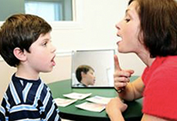
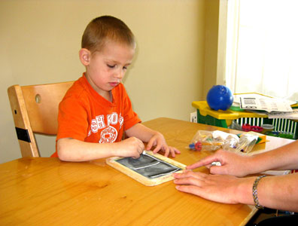
The established interventions for autism, SLP, OT, and Behavior Intervention, do not directly address improving ER.
.
Notes:
There are an abundance of established interventions for autism. Speech Therapy – is great at addressing many of the communication issues that come along with ASD. Occupational therapy addresses some of the fine motor and gross motor challenges inherent with ASD. Applied Behavior Analysis therapy – addresses many areas including academics, communications and adaptive behavioral challenges. All of these approaches TEACH new skills. But it is hard to teach someone who lacks emotional regulation. They get frustrated easily. what is required of the individual for learning is Calm and Focused Attention. This is a tall order for many ASD individuals and it is what makes learning so much more difficult for them. They have a hard time focusing b/c of the sensory challenges, anxiety, adhd and auditory challenges. These are all brain based challenges.
Another highly popular means of addressing ER challenges has been through the use of medications. This may not be the best fit for a population which has inherent sensory challenges.
For ASD, medications target comorbid behavioral symptoms like irritability, hyperactivity, and aggression, Many medications have demonstrated the potential to treat repetitive/stereotyped behaviors, but the efﬁcacy data has not been strong. Even though there is limited research on efficacy of medications, there has been a large increase in the use of MEDS for ASD -

Slide 6
Why NeurOptimal for ASD?
NeurOptimal training is easy to implement.
The process is enjoyable for the client allowing even impulsive, distracted, and anxious youth to, not just endure, but enjoy participating in sessions.
The client is not required to do anything because NeurOptimal training works with the unconscious brain.
Positive results occur within a relatively brief span of time in areas which are often treatment resistant.
The system is portable and easily applied in the home setting.
The research indicates that gains achieved through neurofeedback training sustain themselves after training had stopped.
Autism treatment is often multi-modal, so improving brain performance enhances outcomes for other interventions such as Speech Therapy, OT and Behavioral Interventions.
The training positively affects multiple domains of functioning including socialization, emotional regulation, and academic performance.

Slide 7
NeurOptimal training with ASD Youth
N = 20, females = 4, males = 16
Each received minimum of 10 sessions. 2 participants had 50+ sessions.
Sessions were 33 min in duration - default settings
Tracking of symptoms – anxiety and low frustration tolerance were tracked closely – as they are most associated with self-regulation. Reporting came in the form of interviews with clients, their parents and caregivers. Their perspective considered many domains of functioning – school, home, and community.
In addition to NeurOptimal, the children and youth were also receiving counselling occurring concurrently.
Notes:
The purpose of this report is to share knowledge of encourage others to do what we have been doing at SOS.
This study reviews the results of NeurOptimal training with 20 ASD children and youth ranging in age from age 7 – 20 years old. Participants were middle to high functioning ASD– having average to above average IQ, and attending or attended either elementary or high school. Autism is a spectrum disorder - low functioning to high functioning. The individuals In this report were middle to high functioning.

Slide 8
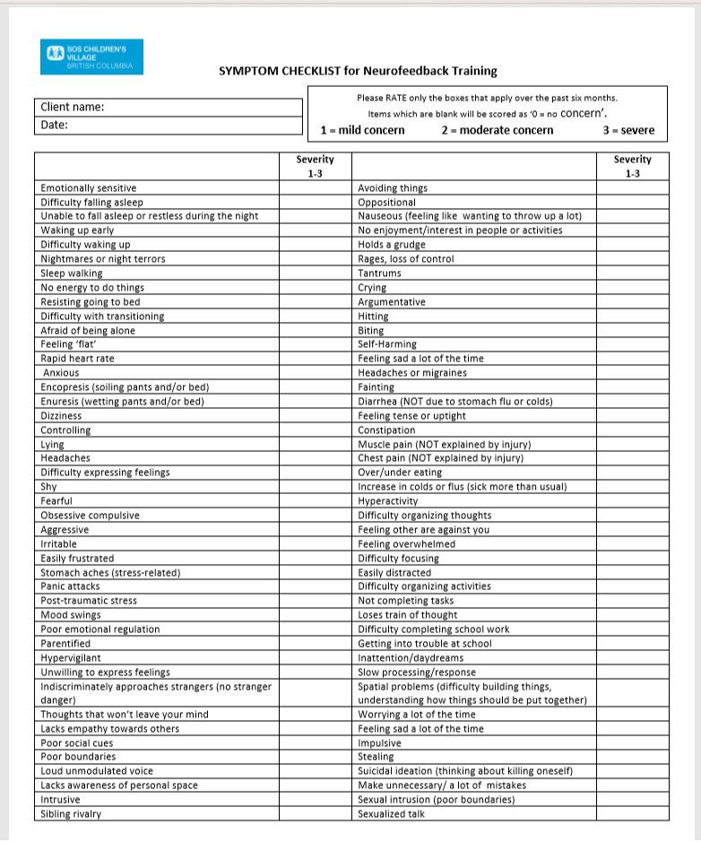
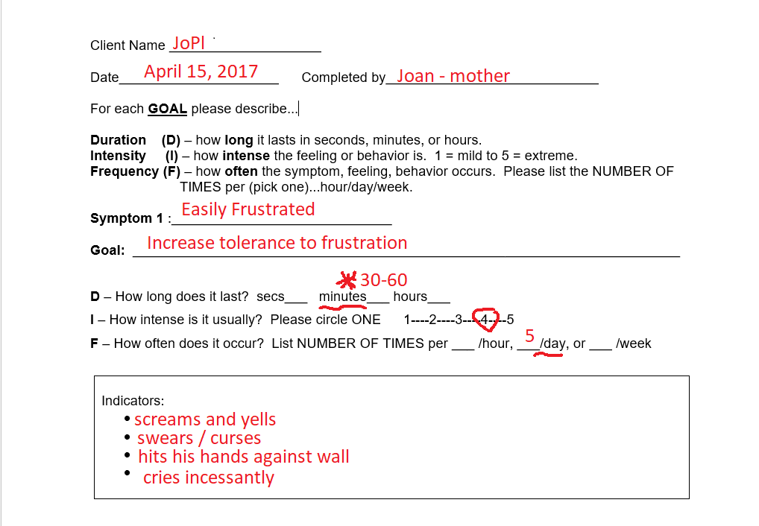
Tracking tools
SOS BC utilizes a version of the NeurOptimal Tracking tools to establish a baseline measure prior to the beginning of training.
Notes:
We always begin with the Symptom checklist - very similar to the NeurOptimal checklist however this one adds a measure of severity to the symptoms 1- mild, 2 moderate, 3 – severe. From this we choose 4 -5 symptoms to look at in more detail. The highest score one can receive on the checklist is 264. The lower the score, the lower the number of issues with symptoms.
We also look at the Duration Intensity and Frequency of symptoms similar to the NeurOptimal tracking sheet, but add some behavioral indicators.

Slide 9
Client | Sympt | # of sessions | Pre Duration | Pre Intensity | Pre Freq. | Post Duration | Post Intensity | Post Freq.
DoMc | Anx | 60 | 1800 sec (30 mins) | 4 | 1/wk | 2 secs | 2 | 1/wk
2. SeWa | LFT | 20 | 12.5m | 3 | 6/day | 7.5m | 3 | 1.5/day
3. JaSe | Anx | 20 | 120m | 4.5 | 25.2/mo | 3m | 2.5 | 1.5/mo
4. AiGi | Anx | 20 | 120m | 3 | 8/mo | 10m | 3 | 3/mo
5. NiBi | LFT | 60 | 60 m | 3 | 3.5wk | 30m | 3 | .5wk
6. KaCh | LFT | 12 | 150m | 4 | 4/day | 20m | 3.5 | 1.5/day
7. SoRo | LFT | 40 | 60min | 1.5 | 3/day | 30min | 1.0 | 1/day
8. EnTh | Anx | 30 | 60min | 4.5 | 1.5/day | 25min | 3.0 | 1.5/day
9. PrNg | LFT | 30 | 1800sec | 5.0 | 1.5/day | 3.5sec | 1.0 | 1.0/day
10. EtKe | LFT | 20 | 25min | 4.0 | 3/day | 10min | 3.0 | 1/day
11. CaBa | LFT | 25 | 20min | 5 | 4.5/day | 1min | 2 | 2/day
12. ErZh | LFT | 40 | 30min | 4 | 3/day | 20min | 3 | 2/day
13. AjBe | LFT | 30 | 30min | 5 | 3.5/w | 1.5m | 4 | 4/w
14. AdMc | LFT | 30 | 1hr | 4 | 4/week | 45min | 3 | 3/ week
15. DoJa | LFT | 20 | 3hrs | 5 | 3/day | 1hr | 4 | 1/day
16. JaAr | LFT | 20 | 6.5 | 3 | 2/day | 3.5 | 3 | 2/day
17. KeCo | Anx | 20 | 30mins | 5 | 8/day | 10min | 3 | 2/wk
18. AvPa | LFT | 20 | 60min | 5 | 4.5/day | 20min | 1.5 | 1.5/day
19. AuBr | LFT | 25 | 20min | 5 | 4.5/wk | 20min | 4 | 2.5/wk
20. DeLa | Anx | 20 | 20min | 5 | 10/wk | 6min | 2.5 | 5/wk
Notes:
20 clients -

Slide 10
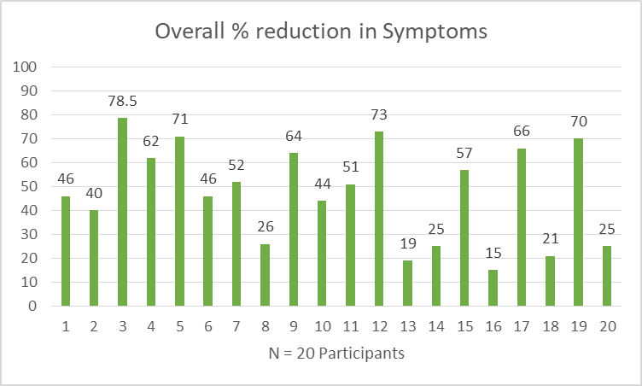
Notes:
This graph represents the 20 participants and displays the % reduction in symptoms related to emotional regulation – either LFT or anxiety. Subject 1 – saw a 46% reduction in the DIF scores. The DIF was averaged.

Slide 11
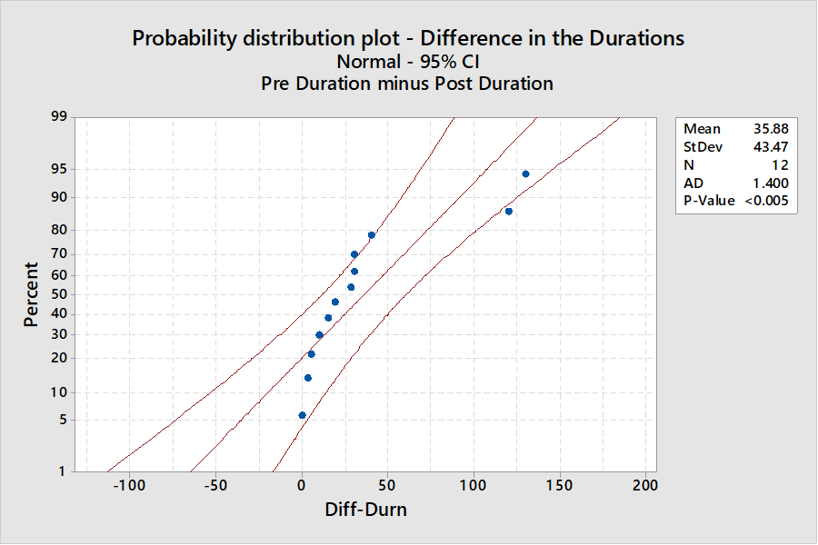
$$H_{o}:μ_{Difference}=0$$
$$H_{a}:μ_{Difference}>0$$
Minitab output.
One-Sample T: Diff-Duration
Test of μ = 0 vs μ > 0
Variable N Mean StDev SE Mean 95% Lower Bound T P
Diff-Dur 12 35.9 43.5 12.5 13.3 2.86 0.008
Notes:
My friend Tariq Nurridin is a statistician at the University of Fraser Valley and he graciously crunched the numbers specific to the Duration of Low Frustration Tolerance- he used Minitab 17 software for all of his calculations. This Probability Distribution plot uses a 95% confidence interval and reveals that some observations were behaving as outliers but the majority fell within the 95% confidence interval band. Thus, it would be safe to assume that the data follows a normal bell shaped distribution. The data is consistent and predictable. That being said, he performed a hypothesis test claiming that the difference of the LFT duration was greater than zero. The one-tailed P-value (Probability value) of 0.008 < 0.05, stating that our hypothesis test is highly significant. Hence, we have strong evidence to accept our alternate hypothesis. We can expect at least a 35.9% improvement in the Duration of LFT. These results need to verified by further study, and there are other variables at play here such as the role of the practitioner, the home environment,

Slide 12
Client | Symptom | # of sessions | Pre Duration | Pre Intensity | Pre Freq. | Post Duration | Post Intensity | Post Freq.
DoMc | Anx | 60 | 1800 sec | 4 | 1/wk | 2 secs | 2 | 1/wk
2. SeWa | LFT | 20 | 12.5m | 3 | 6/day | 7.5m | 3 | 1.5/day
3. JaSe | Anx | 20 | 120m | 4.5 | 25/mo | 3m | 2.5 | 1.5/mo
4. AiGi | Anx | 20 | 120m | 3 | 8/mo | 10m | 3 | 3/mo
5. NiBi | LFT | 60 | 60 m | 3 | 3.5wk | 30m | 3 | .5wk
Notes:
I would like to drill down and examine one client a bit more closely for your benefit. Looking at client 4, AiGi, we see significant reduction in anxiety. The time frame is important to note. In the autism world, parents assume that change will be slow and often expect to not see any change for at least 6 months. With this client, she completed 20 sessions within 4 months. This person, back in December was unable to leave the comfort of her bedroom, had few friends, and rarely ventured out socially. The changes which occurred allowed her to get a full time job working in a busy Starbucks. Within that environment, she has been challenged in many ways which she would not usually have been able to withstand. Prior to training she was easily overwhelmed to the point of uncontrollable crying. 4 months later and she is able now to consciously keep her cool.

Slide 13
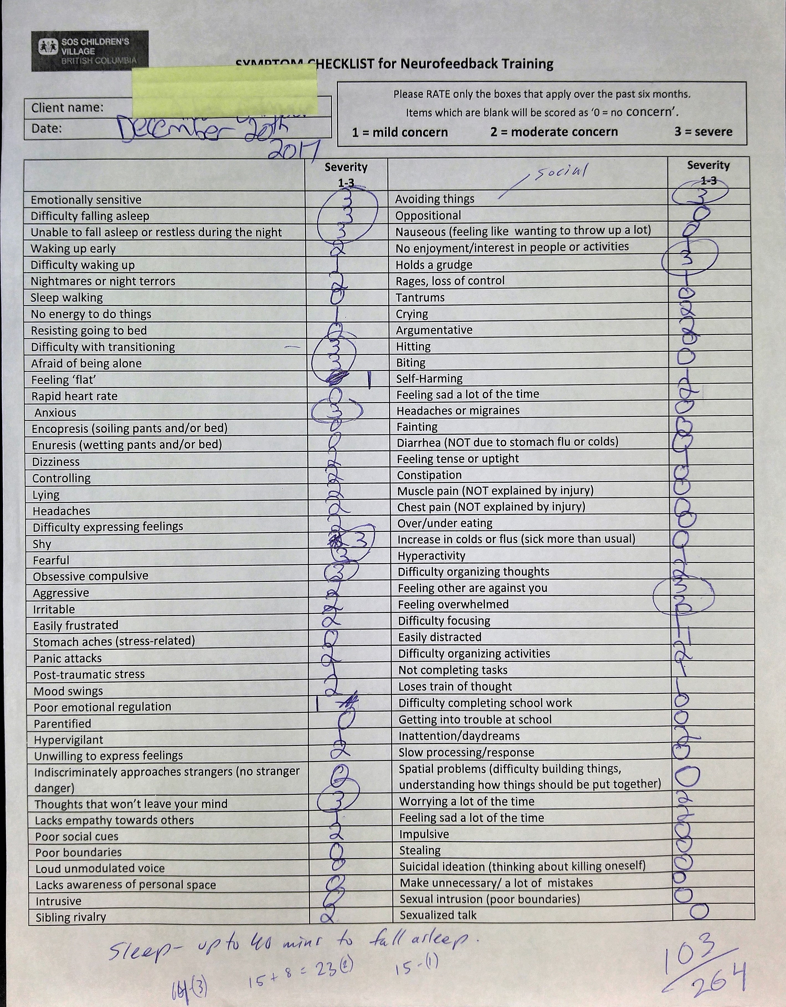
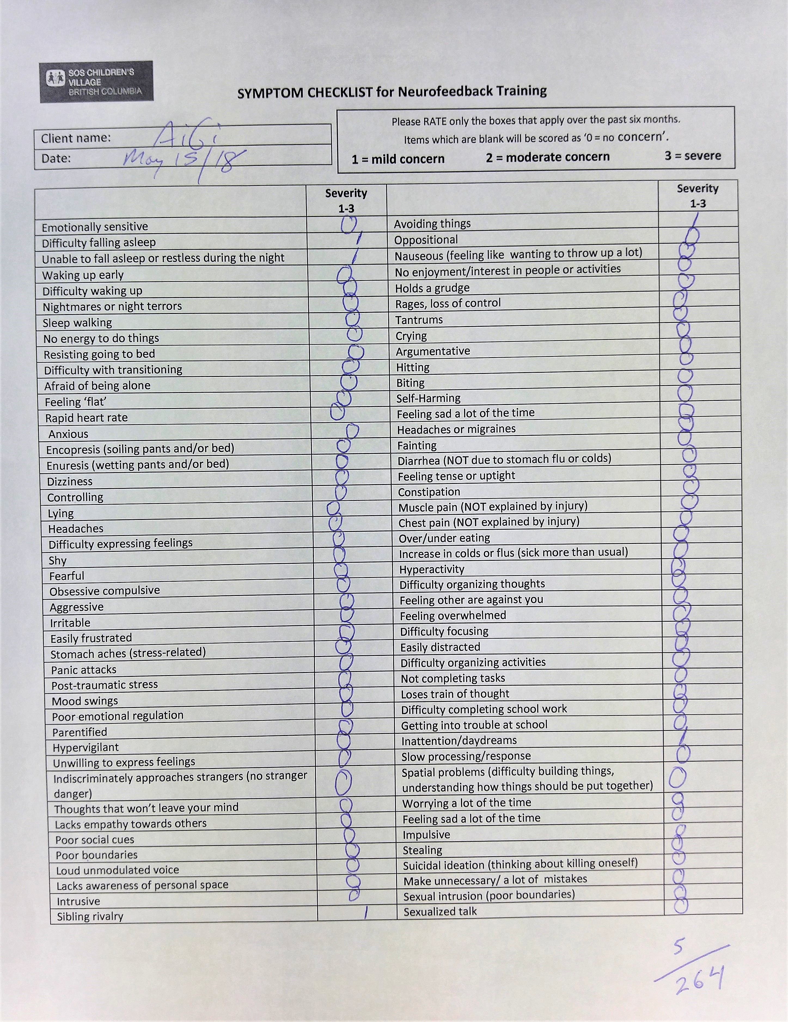
Notes:
ON the left we see her starting point. This was from the initial consult meeting. Note the score at the bottom right, and the number of 3’s indicating Severe concern. I often see this at the starting place and it speaks so loudly to me about how uncomfortable and distressed the individual must be, and how this must impact their ability to perform in school and in relationships.
Just 4 months and 20 sessions later and we see a dramatic difference. The symptoms are not just down, they are almost wiped off the map.

Slide 14
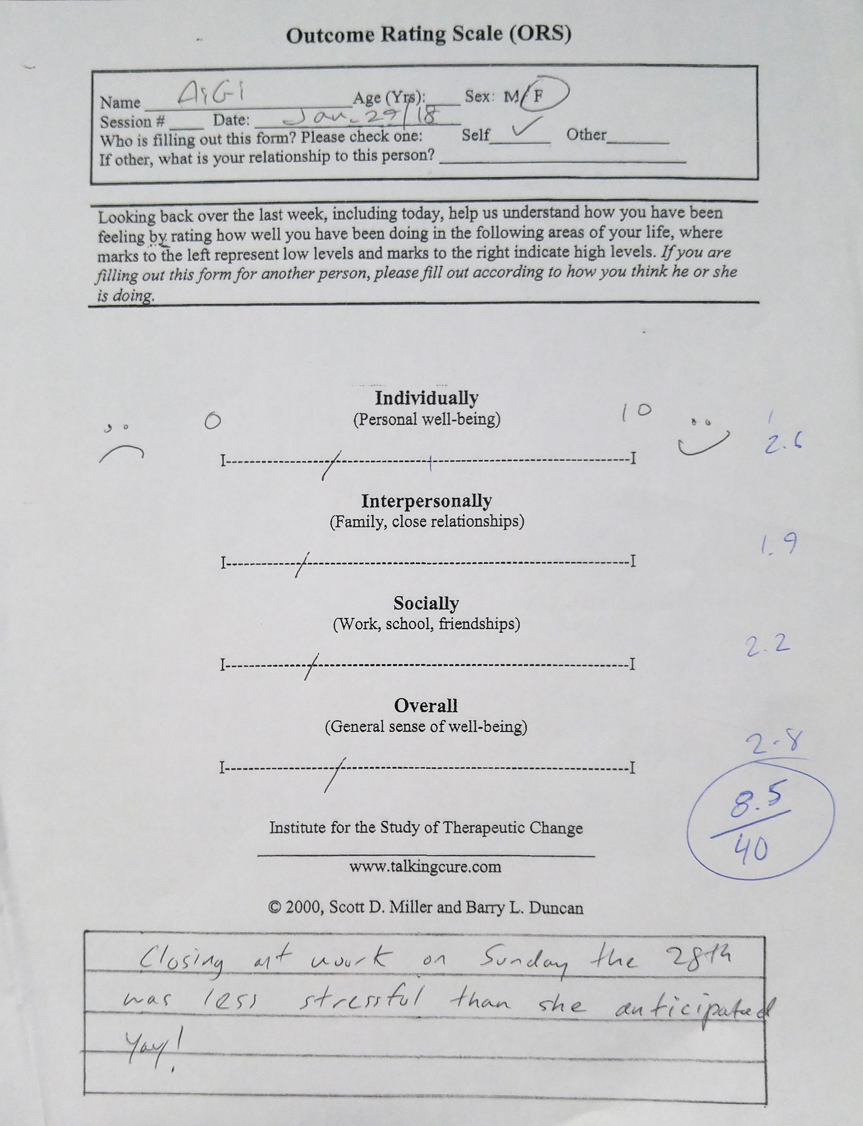
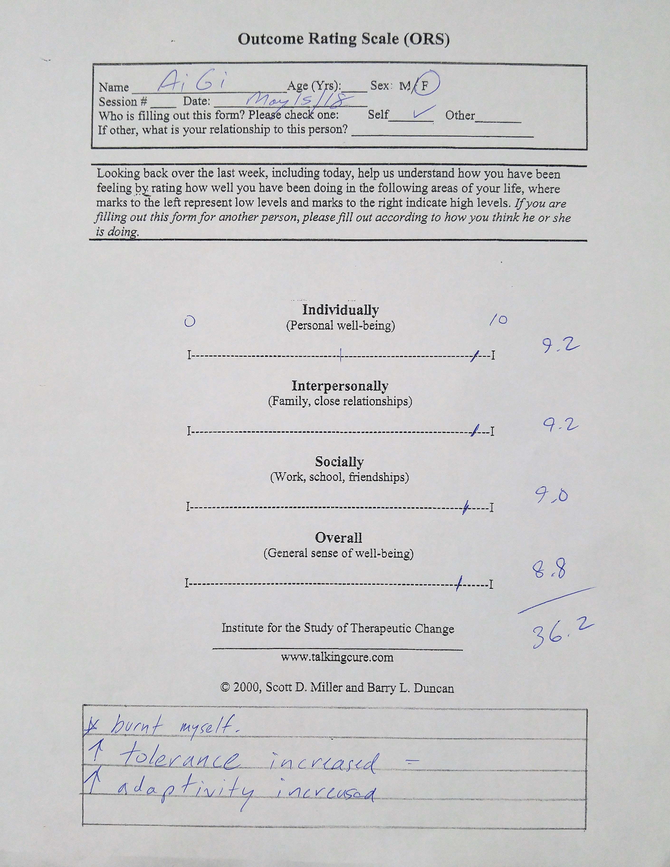
Notes:
At SOS BC we also use the Outcome Rating Scale (ORS) with clients on a weekly basis. The ORS captures the session to session assessment of progress. This brief assessment is used to capture change in clients resulting from psychological intervention and measures three areas of functioning including individual, relational, and social (Campbell & Hemsley, 2009). The higher the overall score out of 40, the greater the improvement of the client in those areas. There is good research related to this tool and its consistency.
Here is the clients first ORS report. This was after 5 sessions. 8.5 / 40 indicates things are not so great in all areas. This was her last ORS, just last week, and tells quite a different story of how this individual is doing.

Slide 15
Notes:
What is nice about the ORS is how easily we can graph the results and see the course of improvement. There was a bit of a setback in March as she reduced sessions down to once a week. Noting this I suggested we go back to 2 sessions per week and progress jumped upward again.

Slide 16
Client | Sympt | # of sessions | Pre Duration | Pre Intensity | Pre Freq. | Post Duration | Post Intensity | Post Freq.
4. AiGi | Anx | 20 | 120m | 3 | 8/mo | 10m | 3 | 3/mo
I have never felt this good in my entire life
Notes:
The results that I have reported here are not unusual. I have seen results like these repeatedly over the past 9 years. Not all clients see the same degree of change at the same rate, but enhancement of emotional regulation has frequently been the outcome.
One aspect which has been hard to measure, but needs addressing is what occurs after the symptoms have come down, As mentioned, this population often has relational difficulties. They do not necessarily want others to enter into their world. In my experience working with several ASD clients for over 4 years what has occurred, once the symptoms came down, was their personality emerged. No longer having difficulties managing intense sensations, has allowed them to engage and interact with the world and the other people in it. Growth occurs in all areas as their trajectory has been altered.

Slide 17
Conclusions:
The work I have reviewed here strongly suggests that the use of NeurOptimal lessens symptoms related to Emotional Regulation for individuals with Autism. These results are consistent with those of Zivoder, Martic-Biocina, Kosic & Bosak (2015) in their study of neurofeedback training for ASD youth, in which they reported changes in behaviour including less aggression, increased cooperation, and communication, improved attention span and sensory motor skills. All subjects in their study accomplished a certain degree of improvement in their level of daily functioning.
Unfortunately, both studies lack a large enough sample size. Therefore a larger study with more controls is needed.
There is a rapidly growing number of NeurOptimal users and my hope is that we can take this to the next level, and formalize some measures and procedures to tighten things up, build a larger group to study, and a better controlled study.
It has been exciting working with this group, who in many respects are outliers in society. Changing their trajectory, by allowing them freedom from their sensory challenges has allowed them to blossom and reach a higher potential.
Notes:
Given the ease of application inherent with NeurOptimal there is a great opportunity to build a larger version of this study with more controls and more subjects. In
It has been exciting working with this group, who in many respects are outliers in society. Changing their trajectory, by allowing them freedom from their sensory challenges has allowed them to blossom and reach a higher potential.
Thanks for allowing me this opportunity to present some of their successes.

Slide 18
Bibliography
Chambers, R., Gullone, E., & Allen, N.B. (2009). Mindful emotion regulation: An integrative review. Clinical Psychology Review, 29(6), 560–572.
Davis, N. O., Kollins, S. H. (2012). Treatment for co-occurring attention deficit/hyperactivity disorder and autism spectrum disorder. Neurotherapeutics, 9, 518-530. doi:10.1007/s13311-012-0126-9 Google Scholar, Crossref, Medline
Mazefsky, C. A., Herrington, J., Siegel, M., Scarpa, A., Maddox, B. B., Scahill, L., & White, S. W. (2013). The role of emotion regulation in autism spectrum disorder. Journal of the American Academy of Child & Adolescent Psychiatry, 52(7), 679–688. doi:10.1016/j.jaac.2013.05.006.
Zivoder, I., Martic-Biocina, S., Kosic, A.V., & Bosak, J. (2015). Neurofeedback Application in the Treatment of Autistic Spectrum Disorders (ASD) Psychiatria Danubina, Vol. 27, Suppl. 1, pp 391–394

